Slide 1
Faltende neuronale netze
Eine Präsentation von Benjamin Jank

Slide 2
Übersicht über Maschinelles Lernen
Künstliche Intelligenz
„ist ein Teilgebiet der Informatik. Sie imitiert menschliche kognitive Fähigkeiten [...]. Diese Intelligenz kann auf programmierten Abläufen basieren oder durch maschinelles Lernen erzeugt werde.“ (Frauenhofer-Institut für Kognitive Systeme IKS)
Maschinelles Lernen
„ist ein Teilbereich der künstlichen Intelligenz (KI). Der Schwerpunkt liegt auf dem Trainieren von Computern, damit diese aus Daten und Erfahrungen lernen […] – anstatt explizit dafür programmiert zu werden.“ (SAP)
Algorithmen
Maschinelles Lernen

Slide 3
Übersicht über Maschinelles Lernen
Algorithmen
Maschinelles Lernen
Input
Input
f(x)
Zustand
f(x)
Output
Output

Slide 4
Übersicht über Maschinelles Lernen
Maschinelles Lernen
Überwachtes
Lernen
unüberwachtes
Lernen
bestärkendes
Lernen
Datensatz, Wahrheitswerte als Input
Lernen auf Basis von Erfahrung
Datensatz als Input
Mustererkennung: Daten clustern
z.B. Lied-Datenbank
KI-System erlernt bestimmtes Verhalten
Verhalten zunächst zufällig
Gewünschtes Verhalten: Belohnung, unerwünschtes Verhalten: Bestrafung
z.B. KI in Computerspiel
Schulterhöhe (cm) | Gewicht (kg) | Wahrheitswert
10 | 10 | 1 (Katze)
35 | 40 | 0 (Hund)
41 | 32 | 0 (Hund)

Slide 5












Ein künstliches neuronales Netz
z₁⁽²⁾ a₁⁽²⁾
$${w22}^{(2)}$$
$${w11}^{(1)}$$
$${w32}^{(2)}$$
x₁
$${w21}^{(1)}$$
z₁⁽³⁾ a₁⁽³⁾
$${w31}^{(1)}$$
$${w22}^{(2)}$$
$${w12}^{(1)}$$
z₂⁽²⁾ a₂⁽²⁾
$${w32}^{(2)}$$
$${w22}^{(1)}$$
x₂
$${w32}^{(1)}$$
z₂⁽³⁾ a₂⁽³⁾
$${w22}^{(2)}$$
$${w32}^{(2)}$$
z₃⁽²⁾ a₃⁽²⁾

Slide 6


Ein künstliches neuronales Netz
$${z\text{1}}^{(2)}{=w11}^{(1)}x1+{w12}^{(1)}x2$$
$${\text{a}\text{1}}^{(2)}=f({z\text{1}}^{(2)})$$
z₁⁽²⁾ a₁⁽²⁾
$${w22}^{(2)}$$
$${w11}^{(1)}$$
$${w32}^{(2)}$$
x₁
$${w21}^{(1)}$$
z₁⁽³⁾ a₁⁽³⁾
$${w31}^{(1)}$$
$${w22}^{(2)}$$
$${w12}^{(1)}$$
z₂⁽²⁾ a₂⁽²⁾
$${w32}^{(2)}$$
$${w22}^{(1)}$$
x₂
$${w32}^{(1)}$$
z₂⁽³⁾ a₂⁽³⁾
$${w22}^{(2)}$$
$${w32}^{(2)}$$
z₃⁽²⁾ a₃⁽²⁾

Slide 7
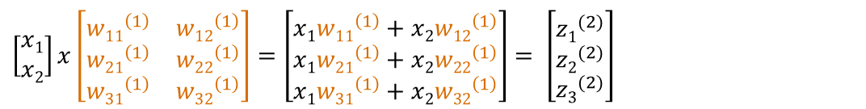
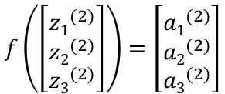

Ein künstliches neuronales Netz
z₁⁽²⁾ a₁⁽²⁾
$${w22}^{(2)}$$
$${w11}^{(1)}$$
$${w32}^{(2)}$$
x₁
$${w21}^{(1)}$$
z₁⁽³⁾ a₁⁽³⁾
$${w31}^{(1)}$$
$${w22}^{(2)}$$
$${w12}^{(1)}$$
z₂⁽²⁾ a₂⁽²⁾
$${w32}^{(2)}$$
$${w22}^{(1)}$$
x₂
$${w32}^{(1)}$$
z₂⁽³⁾ a₂⁽³⁾
$${w22}^{(2)}$$
$${w32}^{(2)}$$
z₃⁽²⁾ a₃⁽²⁾
$\left[\begin{matrix}x1 \\ x2\end{matrix}\right]x\left[\begin{matrix}{w11}^{\left(1\right)} & {w12}^{\left(1\right)} \\ {w21}^{\left(1\right)} & {w22}^{\left(1\right)} \\ {w31}^{\left(1\right)} & {w32}^{\left(1\right)}\end{matrix}\right]$ $=\left[\begin{matrix}x1{w11}^{\left(1\right)}+x2{w12}^{\left(1\right)} \\ x1{w21}^{\left(1\right)}+x2{w22}^{\left(1\right)} \\ x1{w31}^{\left(1\right)}+x2{w32}^{\left(1\right)}\end{matrix}\right]$ $= \left[\begin{matrix}{z1}^{(2)} \\ {z2}^{(2)} \\ {z3}^{(2)}\end{matrix}\right]$
$$f\left(\left[\begin{matrix}{z1}^{(2)} \\ {z2}^{(2)} \\ {z3}^{(2)}\end{matrix}\right]\right)=\left[\begin{matrix}{a1}^{(2)} \\ {a2}^{(2)} \\ {a3}^{(2)}\end{matrix}\right]$$
$\left[\begin{matrix}{a1}^{\left(2\right)} \\ {a2}^{\left(2\right)} \\ {a3}^{\left(2\right)}\end{matrix}\right]x\left[\begin{matrix}{w11}^{\left(2\right)} & {w12}^{\left(2\right)} & {w13}^{\left(2\right)} \\ {w21}^{\left(2\right)} & {w22}^{\left(2\right)} & {w23}^{\left(2\right)}\end{matrix}\right]=\left[\begin{matrix}{a1}^{\left(2\right)}{w11}^{\left(2\right)}+{a2}^{\left(2\right)}{w12}^{\left(2\right)}+{a3}^{\left(2\right)}{w13}^{\left(2\right)} \\ {a1}^{\left(2\right)}{w21}^{\left(2\right)}+{a2}^{\left(2\right)}{w22}^{\left(2\right)}+{a3}^{\left(2\right)}{w23}^{\left(2\right)}\end{matrix}\right]$ $= \left[\begin{matrix}{z1}^{(3)} \\ {z2}^{(3)}\end{matrix}\right]$
$$f\left(\left[\begin{matrix}{z1}^{(3)} \\ {z2}^{(3)}\end{matrix}\right]\right)=\left[\begin{matrix}{a1}^{(3)} \\ {a2}^{(3)}\end{matrix}\right]$$

Slide 8
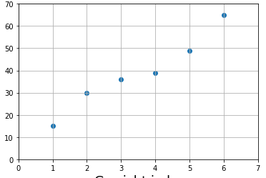
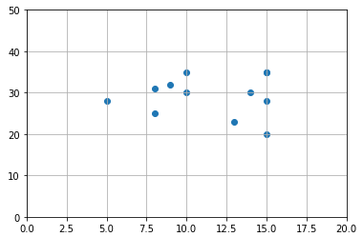
Anwendung von neuronalen Netzen
Regression
Klassifizierung
mit striktem Ansatz (z.B. lineare Funktion f(x)=ax + b) Modellierung sehr eingeschränkt
Neuronale Netze: komplexe Funktion → verschachtelte Funktionen mit einer Vielzahl an Parametern ➔ jede Funktion annähernd darstellbar

Slide 9




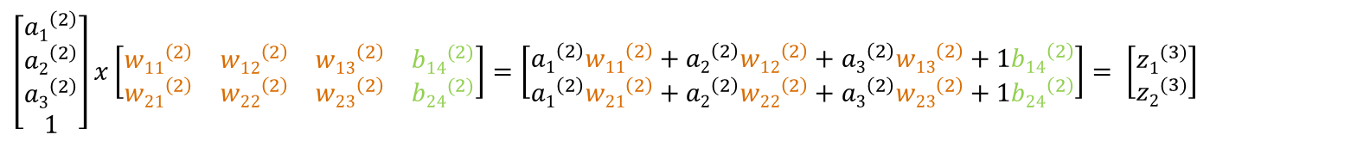





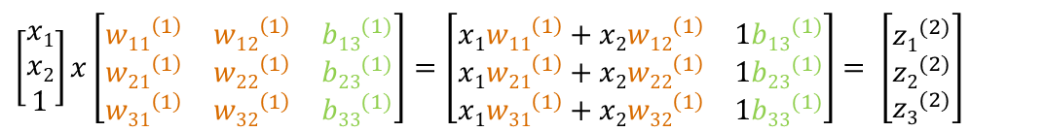





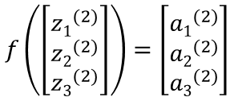




Ein künstliches neuronales Netz
z₁⁽²⁾ a₁⁽²⁾
$${w22}^{(2)}$$
$${w11}^{(1)}$$
$${w32}^{(2)}$$
x₁
$${w21}^{(1)}$$
z₁⁽³⁾ a₁⁽³⁾
$${w31}^{(1)}$$
$${w22}^{(2)}$$
$${w12}^{(1)}$$
z₂⁽²⁾ a₂⁽²⁾
$${w32}^{(2)}$$
$${w22}^{(1)}$$
x₂
$${w32}^{(1)}$$
z₂⁽³⁾ a₂⁽³⁾
$${w22}^{(2)}$$
$${b13}^{(1)}$$
$${w32}^{(2)}$$
$${b23}^{(1)}$$
z₃⁽²⁾ a₃⁽²⁾
₁
$${b33}^{(1)}$$
$${b11}^{(2)}$$
$${b21}^{(2)}$$
₁
$\left[\begin{matrix}x1 \\ x2 \\ 1\end{matrix}\right]x\left[\begin{matrix}{w11}^{\left(1\right)} & {w12}^{\left(1\right)} & {b13}^{(1)} \\ {w21}^{\left(1\right)} & {w22}^{\left(1\right)} & {b23}^{(1)} \\ {w31}^{\left(1\right)} & {w32}^{\left(1\right)} & {b33}^{(1)}\end{matrix}\right]$ $=\left[\begin{matrix}x1{w11}^{\left(1\right)}+x2{w12}^{\left(1\right)} & 1{b13}^{(1)} \\ x1{w21}^{\left(1\right)}+x2{w22}^{\left(1\right)} & 1{b23}^{(1)} \\ x1{w31}^{\left(1\right)}+x2{w32}^{\left(1\right)} & 1{b33}^{(1)}\end{matrix}\right]$ $= \left[\begin{matrix}{z1}^{(2)} \\ {z2}^{(2)} \\ {z3}^{(2)}\end{matrix}\right]$
$$f\left(\left[\begin{matrix}{z1}^{(2)} \\ {z2}^{(2)} \\ {z3}^{(2)}\end{matrix}\right]\right)=\left[\begin{matrix}{a1}^{(2)} \\ {a2}^{(2)} \\ {a3}^{(2)}\end{matrix}\right]$$
$\left[\begin{matrix}{a1}^{\left(2\right)} \\ {a2}^{\left(2\right)} \\ {a3}^{\left(2\right)} \\ 1\end{matrix}\right]x\left[\begin{matrix}{w11}^{\left(2\right)} & {w12}^{\left(2\right)} & {w13}^{\left(2\right)} & {b14}^{(2)} \\ {w21}^{\left(2\right)} & {w22}^{\left(2\right)} & {w23}^{\left(2\right)} & {b24}^{(2)}\end{matrix}\right]=\left[\begin{matrix}{a1}^{\left(2\right)}{w11}^{\left(2\right)}+{a2}^{\left(2\right)}{w12}^{\left(2\right)}+{a3}^{\left(2\right)}{w13}^{\left(2\right)}+1{b14}^{\left(2\right)} \\ {a1}^{\left(2\right)}{w21}^{\left(2\right)}+{a2}^{\left(2\right)}{w22}^{\left(2\right)}+{a3}^{\left(2\right)}{w23}^{\left(2\right)}+1{b24}^{\left(2\right)}\end{matrix}\right]$ $= \left[\begin{matrix}{z1}^{(3)} \\ {z2}^{(3)}\end{matrix}\right]$
$$f\left(\left[\begin{matrix}{z1}^{(3)} \\ {z2}^{(3)}\end{matrix}\right]\right)=\left[\begin{matrix}{a1}^{(3)} \\ {a2}^{(3)}\end{matrix}\right]$$

Slide 10
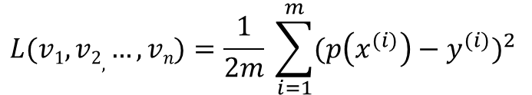
Training eines neuronalen Netzes
Die Fehlerfunktion
Parameter von Model als Eingabe
Gibt Abweichung des Models von Wahrheitswerten zurück
Mean Squared Error Funktion:
Das Gradientenverfahren
Iterativer Algorithmus, um differenzierbare Funktion zu minimieren
Hilfsmittel, um Fehlerfunktion zu optimieren
$$L(v1, v2, …, vn)=\frac{1}{2m} \sum_{i=1}^{m}{{(p\left(x^{(i)}\right)−y^{(i)})}^{2} }$$

Slide 11
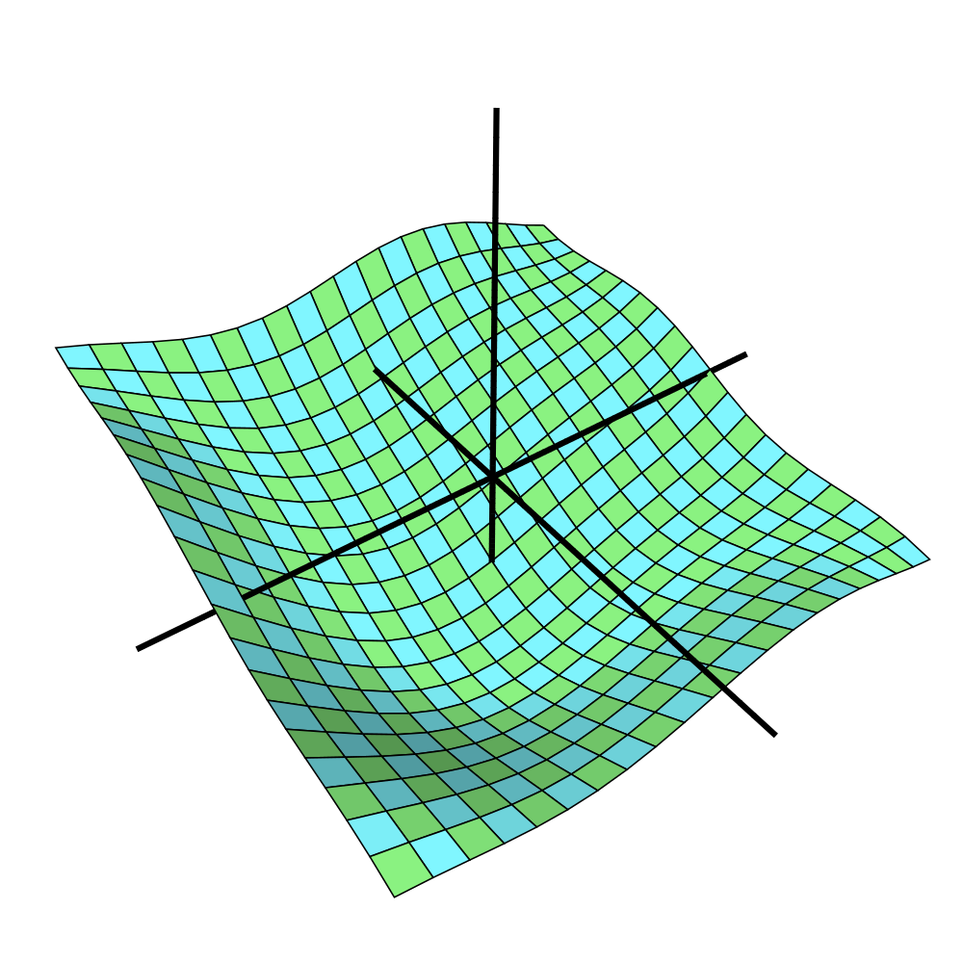
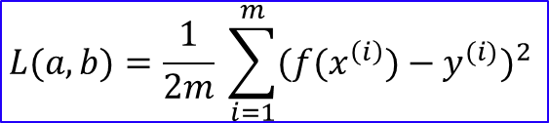

Das Gradientenverfahren
$$f\left(x\right)=ax+b$$
$$L(a, b)=\frac{1}{2m} \sum_{i=1}^{m}{{({f(x}^{\left(i\right)})−y^{(i)})}^{2} }$$
L
a
b
x P

Slide 12
Das Gradientenverfahren
$$f\left(x\right)=ax+b$$
$$L(a, b)=\frac{1}{2m} \sum_{i=1}^{m}{{({f(x}^{\left(i\right)})−y^{(i)})}^{2} }$$
L
x P
a
b

Slide 13
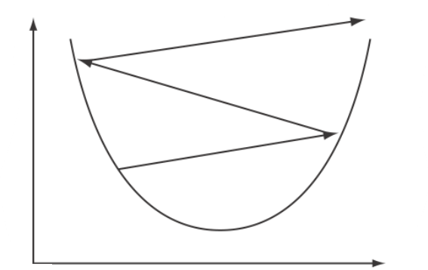
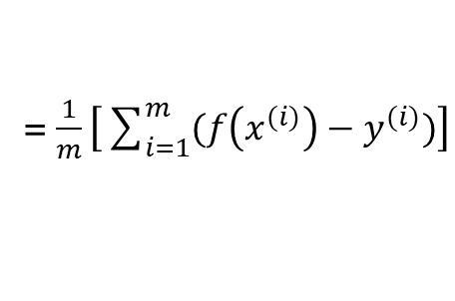


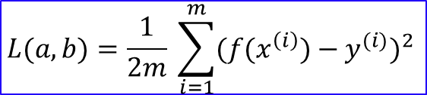



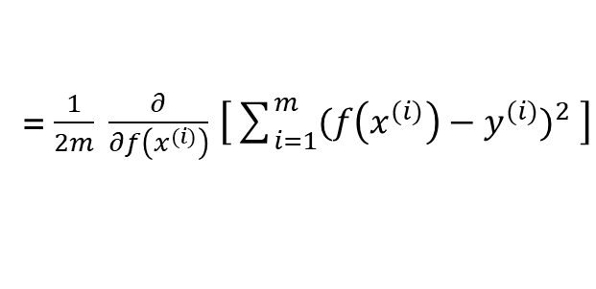
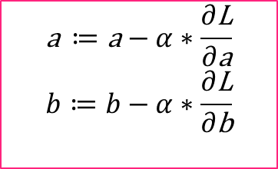
Das Gradientenverfahren
$$f\left(x\right)=ax+b$$
$$L(a, b)=\frac{1}{2m} \sum_{i=1}^{m}{{({f(x}^{\left(i\right)})−y^{(i)})}^{2} }$$
$$\text{a} ≔\text{a}−α∗\frac{∂\text{L}}{∂\text{a}} \\ b≔b−α∗\frac{∂\text{L}}{∂\text{b}}$$
Wichtige Bezeichnungen
$\frac{∂\text{L}}{∂\text{v}}$ = $\frac{∂\text{L}}{∂f\left(x^{(i)}\right)}\frac{∂f\left(x^{(i)}\right)}{∂\text{v}}$
$\frac{∂\text{L}}{∂f\left(x^{(i)}\right)}$ = $\frac{∂}{∂f\left(x^{(i)}\right)}$ $\left[\frac{1}{2m}\sum_{i=1}^{m}{{(f\left(x^{(i)}\right)−y^{(i)})}^{2} }\right]$
= $\frac{1}{2m} \frac{∂}{∂f\left(x^{(i)}\right)}$ $\left[\sum_{i=1}^{m}{{(f\left(x^{(i)}\right)−y^{(i)})}^{2} }\right]$
= $\frac{1}{2m} \left[\sum_{i=1}^{m}{{\frac{∂}{∂f\left(x^{(i)}\right)} (f\left(x^{(i)}\right)−y^{(i)})}^{2} }\right]$
= $\frac{1}{2m} \left[\sum_{i=1}^{m}{2(f\left(x^{(i)}\right)−y^{(i)})}∗\frac{∂}{∂f\left(x^{(i)}\right)} (f\left(x^{(i)}\right)−y^{(i)})\right]$
x P
= $\frac{1}{2m} 2\left[\sum_{i=1}^{m}{(f\left(x^{(i)}\right)−y^{(i)})}\right]$
= $\frac{1}{m}\left[\sum_{i=1}^{m}{(f\left(x^{(i)}\right)−y^{(i)})}\right]$

Slide 14
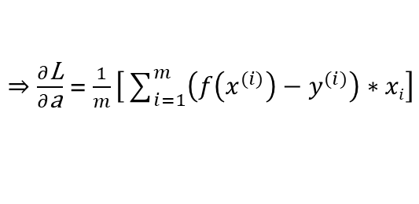
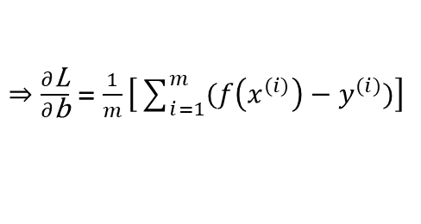
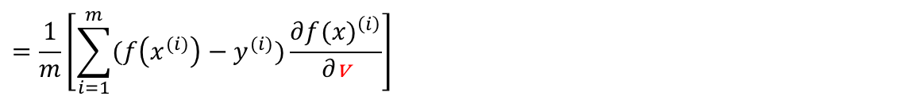
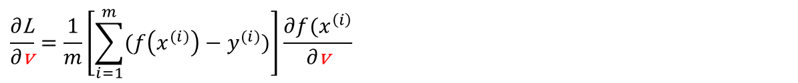

Das Gradientenverfahren
$$f\left(x\right)=ax+b$$
$$L(a, b)=\frac{1}{2m} \sum_{i=1}^{m}{{({f(x}^{\left(i\right)})−y^{(i)})}^{2} }$$
$$\text{a} ≔\text{a}−α∗\frac{∂\text{L}}{∂\text{a}} \\ b≔b−α∗\frac{∂\text{L}}{∂\text{b}}$$
Wichtige Bezeichnungen
$\frac{∂\text{L}}{∂\text{v}}$ = $\frac{∂\text{L}}{∂f\left(x^{(i)}\right)}\frac{∂f\left(x^{(i)}\right)}{∂\text{v}}$
$$\frac{∂\text{L}}{∂\text{v}}=\frac{1}{m}\left[\sum_{i=1}^{m}{(f\left(x^{(i)}\right)−y^{(i)})}\right]\frac{∂{f(x}^{\left(i\right)}}{∂\text{v}}$$
$$=\frac{1}{m}\left[\sum_{i=1}^{m}{(f\left(x^{(i)}\right)−y^{(i)})}\frac{∂{f(x)}^{\left(i\right)}}{∂\text{v}}\right]$$
$⇒\frac{∂\text{L}}{∂\text{b}}$ = $\frac{1}{m}\left[\sum_{i=1}^{m}{(f\left(x^{(i)}\right)−y^{(i)})}\right]$
x P
$⇒\frac{∂\text{L}}{∂\text{a}}$ = $\frac{1}{m}\left[\sum_{i=1}^{m}{\left(f\left(x^{(i)}\right)−y^{(i)}\right)∗xi}\right]$

Slide 15

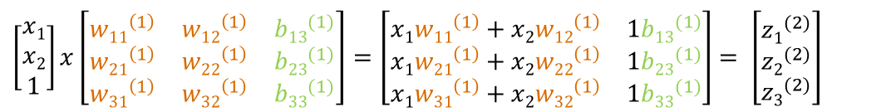

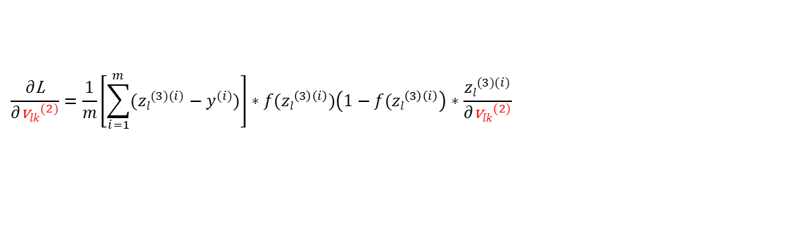
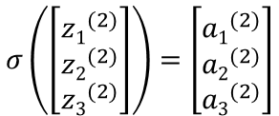
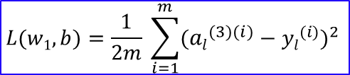
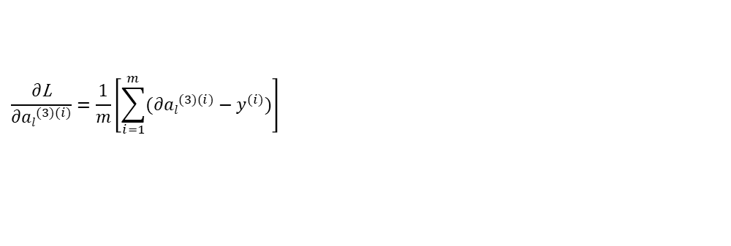


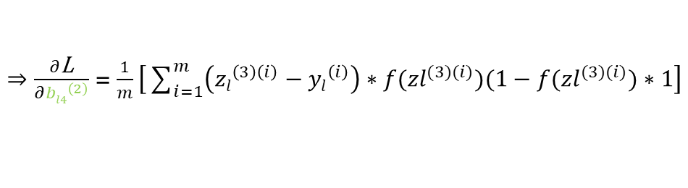
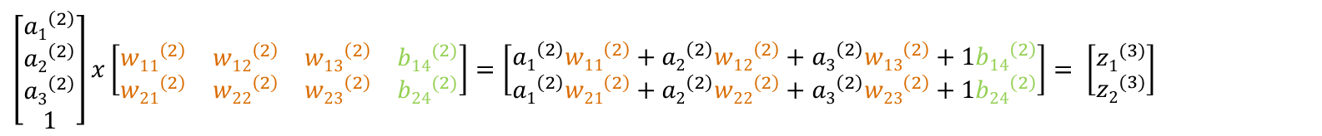
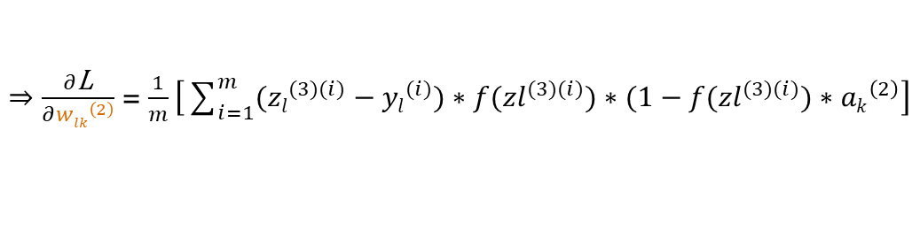

Das Gradientenverfahren
$\left[\begin{matrix}x1 \\ x2 \\ 1\end{matrix}\right]x\left[\begin{matrix}{w11}^{\left(1\right)} & {w12}^{\left(1\right)} & {b13}^{(1)} \\ {w21}^{\left(1\right)} & {w22}^{\left(1\right)} & {b23}^{(1)} \\ {w31}^{\left(1\right)} & {w32}^{\left(1\right)} & {b33}^{(1)}\end{matrix}\right]$ $=\left[\begin{matrix}x1{w11}^{\left(1\right)}+x2{w12}^{\left(1\right)} & 1{b13}^{(1)} \\ x1{w21}^{\left(1\right)}+x2{w22}^{\left(1\right)} & 1{b23}^{(1)} \\ x1{w31}^{\left(1\right)}+x2{w32}^{\left(1\right)} & 1{b33}^{(1)}\end{matrix}\right]$ $= \left[\begin{matrix}{z1}^{(2)} \\ {z2}^{(2)} \\ {z3}^{(2)}\end{matrix}\right]$
$$σ\left(\left[\begin{matrix}{z1}^{(2)} \\ {z2}^{(2)} \\ {z3}^{(2)}\end{matrix}\right]\right)=\left[\begin{matrix}{a1}^{(2)} \\ {a2}^{(2)} \\ {a3}^{(2)}\end{matrix}\right]$$
$\left[\begin{matrix}{a1}^{\left(2\right)} \\ {a2}^{\left(2\right)} \\ {a3}^{\left(2\right)} \\ 1\end{matrix}\right]x\left[\begin{matrix}{w11}^{\left(2\right)} & {w12}^{\left(2\right)} & {w13}^{\left(2\right)} & {b14}^{(2)} \\ {w21}^{\left(2\right)} & {w22}^{\left(2\right)} & {w23}^{\left(2\right)} & {b24}^{(2)}\end{matrix}\right]=\left[\begin{matrix}{a1}^{\left(2\right)}{w11}^{\left(2\right)}+{a2}^{\left(2\right)}{w12}^{\left(2\right)}+{a3}^{\left(2\right)}{w13}^{\left(2\right)}+1{b14}^{\left(2\right)} \\ {a1}^{\left(2\right)}{w21}^{\left(2\right)}+{a2}^{\left(2\right)}{w22}^{\left(2\right)}+{a3}^{\left(2\right)}{w23}^{\left(2\right)}+1{b24}^{\left(2\right)}\end{matrix}\right]$ $= \left[\begin{matrix}{z1}^{(3)} \\ {z2}^{(3)}\end{matrix}\right]$
$$f\left(\left[\begin{matrix}{z1}^{(3)} \\ {z2}^{(3)}\end{matrix}\right]\right)=\left[\begin{matrix}{a1}^{(3)} \\ {a2}^{(3)}\end{matrix}\right]$$
$$L(w1, b)=\frac{1}{2m} \sum_{i=1}^{m}{{({al}^{(3)(i)}−{yl}^{(i)})}^{2} }$$
$${\text{w}lk}^{(2)}≔{\text{w}lk}^{(2)}−α∗\frac{∂\text{L}}{∂{\text{w}lk}^{(2)}}\text{;}{ \text{b}l4}^{(2)}≔{\text{b}l4}^{(2)}−α∗\frac{∂\text{L}}{∂{\text{b}l4}^{(2)}}$$
$$\frac{∂\text{L}}{∂{\text{v}lk}^{(2)}}=\frac{1}{m}\left[\sum_{i=1}^{m}{({zl}^{(3)(i)}−y^{(i)})}∗{f(zl}^{\left(3\right)\left(i\right)})\left(1−{f(zl}^{\left(3\right)\left(i\right)}\right)∗\frac{{zl}^{(3)(i)}}{∂{\text{v}lk}^{(2)}}\right]$$
$\frac{∂\text{L}}{∂{\text{v}lk}^{(2)}}=\frac{∂\text{L}}{∂{al}^{(3)(i)}}\frac{∂{al}^{(3)(i)}}{∂{zl}^{(3)(i)}}$ $\frac{{zl}^{(3)(i)}}{∂{\text{v}lk}^{(2)}}$
$$\frac{∂\text{L}}{∂{al}^{(3)(i)}}=\frac{1}{m}\left[\sum_{i=1}^{m}{(∂{al}^{(3)(i)}−y^{(i)})}\right]$$
$⇒\frac{∂\text{L}}{∂{wlk}^{\left(2\right)}}$ = $\frac{1}{m}\left[\sum_{i=1}^{m}{({zl}^{(3)(i)}−{yl}^{(i)})}∗{f(zl}^{(3)(i)})∗(1−{f(zl}^{(3)(i)})∗{ak}^{\left(2\right)}\right]$
$$\frac{∂{al}^{(3)(i)}}{∂{zl}^{(3)(i)}}=\frac{∂}{∂{zl}^{(3)(i)}}{f(zl}^{(3)(i)})={f(zl}^{(3)(i)})∗(1−{f(zl}^{(3)(i)})$$
$⇒\frac{∂\text{L}}{∂{bl4}^{\left(2\right)}}$ = $\frac{1}{m}\left[\sum_{i=1}^{m}{\left({zl}^{\left(3\right)\left(i\right)}−{yl}^{\left(i\right)}\right)∗{f(zl}^{(3)(i)})(1−{f(zl}^{(3)(i)})}∗1\right]$
$\frac{∂{zl}^{(3)(i)}}{∂{\text{v}lk}^{(2)}}=$ $\frac{∂}{∂{\text{v}lk}^{(2)}} \left({a1}^{\left(2\right)(i)}{wl1}^{\left(2\right)}+{a2}^{\left(2\right)(i)}{wl2}^{\left(2\right)}+{a3}^{\left(2\right)(i)}{wl3}^{\left(2\right)}+1{bl4}^{\left(2\right)}\right)$
$$\frac{∂\text{L}}{∂{\text{v}lk}^{(2)}}=\frac{1}{m}\left[\sum_{i=1}^{m}{({zl}^{(3)(i)}−y^{(i)})}\right]∗{f(zl}^{\left(3\right)\left(i\right)})\left(1−{f(zl}^{\left(3\right)\left(i\right)}\right)∗\frac{{zl}^{(3)(i)}}{∂{\text{v}lk}^{(2)}}$$

Slide 16




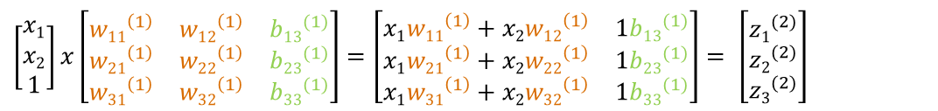
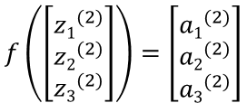
Das Gradientenverfahren
$\left[\begin{matrix}x1 \\ x2 \\ 1\end{matrix}\right]x\left[\begin{matrix}{w11}^{\left(1\right)} & {w12}^{\left(1\right)} & {b13}^{(1)} \\ {w21}^{\left(1\right)} & {w22}^{\left(1\right)} & {b23}^{(1)} \\ {w31}^{\left(1\right)} & {w32}^{\left(1\right)} & {b33}^{(1)}\end{matrix}\right]$ $=\left[\begin{matrix}x1{w11}^{\left(1\right)}+x2{w12}^{\left(1\right)} & 1{b13}^{(1)} \\ x1{w21}^{\left(1\right)}+x2{w22}^{\left(1\right)} & 1{b23}^{(1)} \\ x1{w31}^{\left(1\right)}+x2{w32}^{\left(1\right)} & 1{b33}^{(1)}\end{matrix}\right]$ $= \left[\begin{matrix}{z1}^{(2)} \\ {z2}^{(2)} \\ {z3}^{(2)}\end{matrix}\right]$
$$f\left(\left[\begin{matrix}{z1}^{(2)} \\ {z2}^{(2)} \\ {z3}^{(2)}\end{matrix}\right]\right)=\left[\begin{matrix}{a1}^{(2)} \\ {a2}^{(2)} \\ {a3}^{(2)}\end{matrix}\right]$$
$\left[\begin{matrix}{a1}^{\left(2\right)} \\ {a2}^{\left(2\right)} \\ {a3}^{\left(2\right)} \\ 1\end{matrix}\right]x\left[\begin{matrix}{w11}^{\left(2\right)} & {w12}^{\left(2\right)} & {w13}^{\left(2\right)} & {b14}^{(2)} \\ {w21}^{\left(2\right)} & {w22}^{\left(2\right)} & {w23}^{\left(2\right)} & {b24}^{(2)}\end{matrix}\right]=\left[\begin{matrix}{a1}^{\left(2\right)}{w11}^{\left(2\right)}+{a2}^{\left(2\right)}{w12}^{\left(2\right)}+{a3}^{\left(2\right)}{w13}^{\left(2\right)}+1{b14}^{\left(2\right)} \\ {a1}^{\left(2\right)}{w21}^{\left(2\right)}+{a2}^{\left(2\right)}{w22}^{\left(2\right)}+{a3}^{\left(2\right)}{w23}^{\left(2\right)}+1{b24}^{\left(2\right)}\end{matrix}\right]$ $= \left[\begin{matrix}{z1}^{(3)} \\ {z2}^{(3)}\end{matrix}\right]$
$$f\left(\left[\begin{matrix}{z1}^{(3)} \\ {z2}^{(3)}\end{matrix}\right]\right)=\left[\begin{matrix}{a1}^{(3)} \\ {a2}^{(3)}\end{matrix}\right]$$
$$L(w1, b)=\frac{1}{2m} \sum_{i=1}^{m}{{({al}^{(3)(i)}−{yl}^{(i)})}^{2} }$$
$${\text{w}kj}^{(1)}≔{\text{w}kj}^{(1)}−α∗\frac{∂\text{L}}{∂{\text{w}kj}^{(1)}}\text{;}{ \text{b}k3}^{(1)}≔{ \text{b}k3}^{(1)}−α∗\frac{∂\text{L}}{{ \text{b}k3}^{(1)}}$$
$$\frac{∂\text{L}}{∂{\text{v}kj}^{(1)}}=\frac{∂\text{L}}{∂{al}^{(3)(i)}}\frac{∂{al}^{(3)(i)}}{∂{zl}^{(3)(i)}}\frac{∂{zl}^{(3)(i)}}{∂{ak}^{(2)(i)}}\frac{∂{ak}^{(2)(i)}}{∂{zk}^{\left(2\right)\left(i\right)}}\frac{{∂zk}^{\left(2\right)\left(i\right)}}{∂{\text{v}kj}^{(1)}}$$
$$\frac{{∂zl}^{(3)(i)}}{∂{ak}^{(2)(i)}}=\frac{∂}{∂{ak}^{(2)(i)}}\left({a1}^{\left(2\right)(i)}{wl1}^{\left(2\right)}+{a2}^{\left(2\right)(i)}{wl2}^{\left(2\right)}+{a3}^{\left(2\right)(i)}{wl3}^{\left(2\right)}+1{bl4}^{\left(2\right)}\right)={wlk}^{(2)}$$
$$\frac{∂{ak}^{(2)(i)}}{∂{zk}^{\left(2\right)\left(i\right)}}=\frac{∂}{{∂zk}^{\left(2\right)\left(i\right)}}σ({zk}^{\left(2\right)\left(i\right)})=σ\left({zk}^{\left(2\right)\left(i\right)}\right)∗\left(1−σ\left({zk}^{\left(2\right)\left(i\right)}\right)\right)$$
$$\frac{{∂zk}^{\left(2\right)\left(i\right)}}{∂{\text{v}kj}^{(1)}}=\frac{∂}{∂{\text{v}kj}^{(1)}}\left(x1{wk1}^{\left(1\right)}+x2{wk2}^{\left(1\right)}+1{bk4}^{\left(1\right)}\right)$$
$$\frac{∂\text{L}}{∂{\text{v}kj}^{(1)}}=\frac{1}{m}\left[\sum_{i=1}^{m}{({zl}^{(3)(i)}−y^{(i)})}\right]∗{f(zl}^{(3)(i)})\left(1−{f(zl}^{\left(3\right)\left(i\right)}\right)∗{wlk}^{\left(2\right)}∗σ\left({zk}^{\left(2\right)\left(i\right)}\right)\left(1−σ\left({zk}^{\left(2\right)\left(i\right)}\right)\right)∗\frac{∂}{∂{\text{v}kj}^{(1)}}\left(x1{wk1}^{\left(1\right)}+x2{wk2}^{\left(1\right)}+1{bk4}^{\left(1\right)}\right)$$

Slide 17
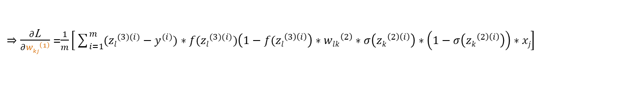
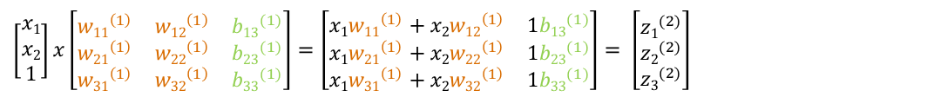
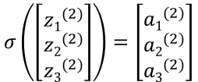

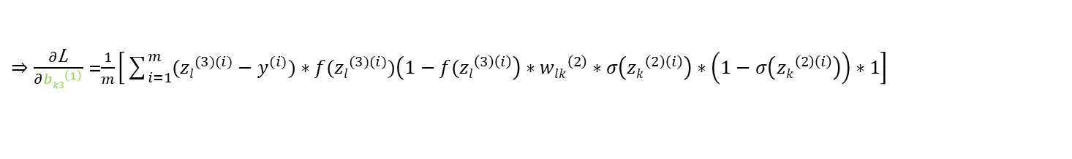
Das Gradientenverfahren
$\left[\begin{matrix}x1 \\ x2 \\ 1\end{matrix}\right]x\left[\begin{matrix}{w11}^{\left(1\right)} & {w12}^{\left(1\right)} & {b13}^{(1)} \\ {w21}^{\left(1\right)} & {w22}^{\left(1\right)} & {b23}^{(1)} \\ {w31}^{\left(1\right)} & {w32}^{\left(1\right)} & {b33}^{(1)}\end{matrix}\right]$ $=\left[\begin{matrix}x1{w11}^{\left(1\right)}+x2{w12}^{\left(1\right)} & 1{b13}^{(1)} \\ x1{w21}^{\left(1\right)}+x2{w22}^{\left(1\right)} & 1{b23}^{(1)} \\ x1{w31}^{\left(1\right)}+x2{w32}^{\left(1\right)} & 1{b33}^{(1)}\end{matrix}\right]$ $= \left[\begin{matrix}{z1}^{(2)} \\ {z2}^{(2)} \\ {z3}^{(2)}\end{matrix}\right]$
$$σ\left(\left[\begin{matrix}{z1}^{(2)} \\ {z2}^{(2)} \\ {z3}^{(2)}\end{matrix}\right]\right)=\left[\begin{matrix}{a1}^{(2)} \\ {a2}^{(2)} \\ {a3}^{(2)}\end{matrix}\right]$$
$\left[\begin{matrix}{a1}^{\left(2\right)} \\ {a2}^{\left(2\right)} \\ {a3}^{\left(2\right)} \\ 1\end{matrix}\right]x\left[\begin{matrix}{w11}^{\left(2\right)} & {w12}^{\left(2\right)} & {w13}^{\left(2\right)} & {b14}^{(2)} \\ {w21}^{\left(2\right)} & {w22}^{\left(2\right)} & {w23}^{\left(2\right)} & {b24}^{(2)}\end{matrix}\right]=\left[\begin{matrix}{a1}^{\left(2\right)}{w11}^{\left(2\right)}+{a2}^{\left(2\right)}{w12}^{\left(2\right)}+{a3}^{\left(2\right)}{w13}^{\left(2\right)}+1{b14}^{\left(2\right)} \\ {a1}^{\left(2\right)}{w21}^{\left(2\right)}+{a2}^{\left(2\right)}{w22}^{\left(2\right)}+{a3}^{\left(2\right)}{w23}^{\left(2\right)}+1{b24}^{\left(2\right)}\end{matrix}\right]$ $= \left[\begin{matrix}{z1}^{(3)} \\ {z2}^{(3)}\end{matrix}\right]$
$$f\left(\left[\begin{matrix}{z1}^{(3)} \\ {z2}^{(3)}\end{matrix}\right]\right)=\left[\begin{matrix}{a1}^{(3)} \\ {a2}^{(3)}\end{matrix}\right]$$
$$L(w1, b)=\frac{1}{2m} \sum_{i=1}^{m}{{({al}^{(3)(i)}−{yl}^{(i)})}^{2} }$$
$${\text{w}kj}^{(1)}≔{\text{w}kj}^{(1)}−α∗\frac{∂\text{L}}{∂{\text{w}kj}^{(1)}}\text{;}{ \text{b}k3}^{(1)}≔{ \text{b}k3}^{(1)}−α∗\frac{∂\text{L}}{{ \text{b}k3}^{(1)}}$$
$$\frac{∂\text{L}}{∂{\text{v}kj}^{(1)}}=\frac{1}{m}\left[\sum_{i=1}^{m}{({zl}^{(3)(i)}−y^{(i)})}\right]∗{f(zl}^{(3)(i)})\left(1−{f(zl}^{\left(3\right)\left(i\right)}\right)∗{wlk}^{\left(2\right)}∗σ\left({zk}^{\left(2\right)\left(i\right)}\right)\left(1−σ\left({zk}^{\left(2\right)\left(i\right)}\right)\right)∗\frac{∂}{∂{\text{v}kj}^{(1)}}\left(x1{wk1}^{\left(1\right)}+x2{wk2}^{\left(1\right)}+1{bk4}^{\left(1\right)}\right)$$
$⇒\frac{∂\text{L}}{∂{wkj}^{\left(1\right)}}$ =$\frac{1}{m}\left[\sum_{i=1}^{m}{({zl}^{(3)(i)}−y^{(i)}){∗f(zl}^{(3)(i)})\left(1−{f(zl}^{\left(3\right)\left(i\right)}\right)}∗{wlk}^{\left(2\right)}∗σ\left({zk}^{\left(2\right)\left(i\right)}\right)∗\left(1−σ\left({zk}^{\left(2\right)\left(i\right)}\right)\right)∗xj\right]$
$⇒\frac{∂\text{L}}{∂{bk3}^{\left(1\right)}}$ =$\frac{1}{m}\left[\sum_{i=1}^{m}{({zl}^{(3)(i)}−y^{(i)})}{∗f(zl}^{(3)(i)})\left(1−{f(zl}^{\left(3\right)\left(i\right)}\right)∗{wlk}^{\left(2\right)}∗σ\left({zk}^{\left(2\right)\left(i\right)}\right)∗\left(1−σ\left({zk}^{\left(2\right)\left(i\right)}\right)\right)∗1\right]$

Slide 18

















Ein faltendes neuronales Netz
z₁⁽²⁾ a₁⁽²⁾
$${w22}^{(2)}$$
$${w11}^{(1)}$$
$${w32}^{(2)}$$
x₁
$${w21}^{(1)}$$
z₁⁽³⁾ a₁⁽³⁾
$${w31}^{(1)}$$
$${w22}^{(2)}$$
$${w12}^{(1)}$$
z₂⁽²⁾ a₂⁽²⁾
$${w32}^{(2)}$$
x₂
$${w22}^{(1)}$$
$${w32}^{(1)}$$
z₂⁽³⁾ a₂⁽³⁾
$${w22}^{(2)}$$
$${b13}^{(1)}$$
$${w32}^{(2)}$$
$${b23}^{(1)}$$
z₃⁽²⁾ a₃⁽²⁾
₁
$${b33}^{(1)}$$
$${b11}^{(2)}$$
$${b21}^{(2)}$$
₁
faltende
Schicht
faltende
Schicht

Slide 19
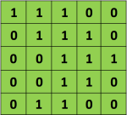





Ein faltendes neuronales Netz
$$\left[\begin{matrix}12 & 9 & 12 \\ 6 & 12 & 9 \\ 6 & 9 & 12\end{matrix}\right]$$
$$f\left(\left[\begin{matrix}12 & 9 & 12 \\ 6 & 12 & 9 \\ 6 & 9 & 12\end{matrix}\right]\right)$$
$$\left[\begin{matrix}12 & 9 & 12 \\ 6 & 12 & 9 \\ 6 & 9 & 12\end{matrix}\right]$$
$$\left[\begin{matrix}12 & 12 \\ 12 & 12\end{matrix}\right]$$
Dimensionen von Fenster: 2x2
→ Max-Pooling
→ Durchschnitt-Pooling
Faltungs-Schritt (Convolution)
Aktivierungsfunktion
Pooling

Slide 20

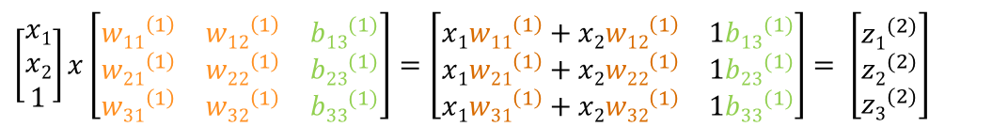

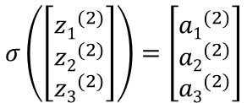

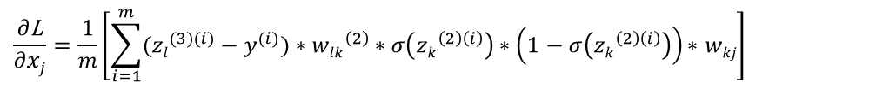


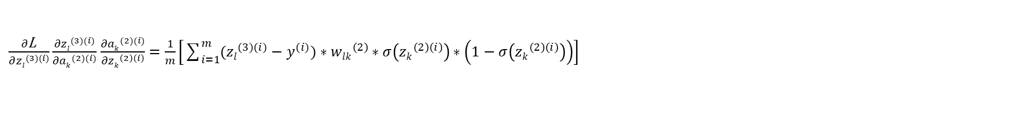
Das Multilayer Perceptron
C1
C2
$\left[\begin{matrix}x1 \\ x2 \\ 1\end{matrix}\right]x\left[\begin{matrix}{w11}^{\left(1\right)} & {w12}^{\left(1\right)} & {b13}^{(1)} \\ {w21}^{\left(1\right)} & {w22}^{\left(1\right)} & {b23}^{(1)} \\ {w31}^{\left(1\right)} & {w32}^{\left(1\right)} & {b33}^{(1)}\end{matrix}\right]$ $=\left[\begin{matrix}x1{w11}^{\left(1\right)}+x2{w12}^{\left(1\right)} & 1{b13}^{(1)} \\ x1{w21}^{\left(1\right)}+x2{w22}^{\left(1\right)} & 1{b23}^{(1)} \\ x1{w31}^{\left(1\right)}+x2{w32}^{\left(1\right)} & 1{b33}^{(1)}\end{matrix}\right]$ $= \left[\begin{matrix}{z1}^{(2)} \\ {z2}^{(2)} \\ {z3}^{(2)}\end{matrix}\right]$
$$σ\left(\left[\begin{matrix}{z1}^{(2)} \\ {z2}^{(2)} \\ {z3}^{(2)}\end{matrix}\right]\right)=\left[\begin{matrix}{a1}^{(2)} \\ {a2}^{(2)} \\ {a3}^{(2)}\end{matrix}\right]$$
$\left[\begin{matrix}{a1}^{\left(2\right)} \\ {a2}^{\left(2\right)} \\ {a3}^{\left(2\right)} \\ 1\end{matrix}\right]x\left[\begin{matrix}{w11}^{\left(2\right)} & {w12}^{\left(2\right)} & {w13}^{\left(2\right)} & {b14}^{(2)} \\ {w21}^{\left(2\right)} & {w22}^{\left(2\right)} & {w23}^{\left(2\right)} & {b24}^{(2)}\end{matrix}\right]=\left[\begin{matrix}{a1}^{\left(2\right)}{w11}^{\left(2\right)}+{a2}^{\left(2\right)}{w12}^{\left(2\right)}+{a3}^{\left(2\right)}{w13}^{\left(2\right)}+1{b14}^{\left(2\right)} \\ {a1}^{\left(2\right)}{w21}^{\left(2\right)}+{a2}^{\left(2\right)}{w22}^{\left(2\right)}+{a3}^{\left(2\right)}{w23}^{\left(2\right)}+1{b24}^{\left(2\right)}\end{matrix}\right]$ $= \left[\begin{matrix}{z1}^{(3)} \\ {z2}^{(3)}\end{matrix}\right]$
$$f\left(\left[\begin{matrix}{z1}^{(3)} \\ {z2}^{(3)}\end{matrix}\right]\right)=\left[\begin{matrix}{a1}^{(3)} \\ {a2}^{(3)}\end{matrix}\right]$$
$$L(w1, b)=\frac{1}{2m} \sum_{i=1}^{m}{{({zl}^{(3)(i)}−{yl}^{(i)})}^{2} }$$
$${\text{w}ih}^{(0)}≔{\text{w}ih}^{(0)}−α∗\frac{∂\text{L}}{∂{\text{w}ih}^{(0)}}$$
$\frac{∂\text{L}}{∂{\text{w}ih}^{(0)}}=\frac{∂\text{L}}{∂{zl}^{(3)(i)}}\frac{{∂zl}^{(3)(i)}}{∂{ak}^{(2)(i)}}$ $\frac{∂{ak}^{(2)(i)}}{∂{zk}^{\left(2\right)\left(i\right)}}\frac{{∂zk}^{\left(2\right)\left(i\right)}}{∂xj}\frac{∂xj}{{\text{w}ih}^{(0)}}$
$\frac{∂\text{L}}{∂{zl}^{(3)(i)}}\frac{{∂zl}^{(3)(i)}}{∂{ak}^{(2)(i)}}$ $\frac{∂{ak}^{(2)(i)}}{∂{zk}^{\left(2\right)\left(i\right)}}=\frac{1}{m}\left[\sum_{i=1}^{m}{({zl}^{(3)(i)}−y^{(i)})}∗{wlk}^{\left(2\right)}∗σ\left({zk}^{\left(2\right)\left(i\right)}\right)∗\left(1−σ\left({zk}^{\left(2\right)\left(i\right)}\right)\right)\right]$
$$\frac{{∂zk}^{\left(2\right)\left(i\right)}}{∂xj}=\frac{∂}{∂xj}\left(x1{wk1}^{\left(1\right)}+x2{wk2}^{\left(1\right)}+1{bk4}^{\left(1\right)}\right)=wkj$$
$$\frac{∂\text{L}}{∂xj}=\frac{1}{m}\left[\sum_{i=1}^{m}{({zl}^{(3)(i)}−y^{(i)})}∗{wlk}^{\left(2\right)}∗σ\left({zk}^{\left(2\right)\left(i\right)}\right)∗\left(1−σ\left({zk}^{\left(2\right)\left(i\right)}\right)\right)\text{∗ }wkj\right]$$

Slide 21
































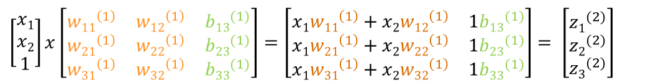








Das Multilayer Perceptron
C1
C2
$\left[\begin{matrix}x1 \\ x2 \\ 1\end{matrix}\right]x\left[\begin{matrix}{w11}^{\left(1\right)} & {w12}^{\left(1\right)} & {b13}^{(1)} \\ {w21}^{\left(1\right)} & {w22}^{\left(1\right)} & {b23}^{(1)} \\ {w31}^{\left(1\right)} & {w32}^{\left(1\right)} & {b33}^{(1)}\end{matrix}\right]$ $=\left[\begin{matrix}x1{w11}^{\left(1\right)}+x2{w12}^{\left(1\right)} & 1{b13}^{(1)} \\ x1{w21}^{\left(1\right)}+x2{w22}^{\left(1\right)} & 1{b23}^{(1)} \\ x1{w31}^{\left(1\right)}+x2{w32}^{\left(1\right)} & 1{b33}^{(1)}\end{matrix}\right]$ $= \left[\begin{matrix}{z1}^{(2)} \\ {z2}^{(2)} \\ {z3}^{(2)}\end{matrix}\right]$
$$σ\left(\left[\begin{matrix}{z1}^{(2)} \\ {z2}^{(2)} \\ {z3}^{(2)}\end{matrix}\right]\right)=\left[\begin{matrix}{a1}^{(2)} \\ {a2}^{(2)} \\ {a3}^{(2)}\end{matrix}\right]$$
$\left[\begin{matrix}{a1}^{\left(2\right)} \\ {a2}^{\left(2\right)} \\ {a3}^{\left(2\right)} \\ 1\end{matrix}\right]x\left[\begin{matrix}{w11}^{\left(2\right)} & {w12}^{\left(2\right)} & {w13}^{\left(2\right)} & {b14}^{(2)} \\ {w21}^{\left(2\right)} & {w22}^{\left(2\right)} & {w23}^{\left(2\right)} & {b24}^{(2)}\end{matrix}\right]=\left[\begin{matrix}{a1}^{\left(2\right)}{w11}^{\left(2\right)}+{a2}^{\left(2\right)}{w12}^{\left(2\right)}+{a3}^{\left(2\right)}{w13}^{\left(2\right)}+1{b14}^{\left(2\right)} \\ {a1}^{\left(2\right)}{w21}^{\left(2\right)}+{a2}^{\left(2\right)}{w22}^{\left(2\right)}+{a3}^{\left(2\right)}{w23}^{\left(2\right)}+1{b24}^{\left(2\right)}\end{matrix}\right]$ $= \left[\begin{matrix}{z1}^{(3)} \\ {z2}^{(3)}\end{matrix}\right]$
$$f\left(\left[\begin{matrix}{z1}^{(3)} \\ {z2}^{(3)}\end{matrix}\right]\right)=\left[\begin{matrix}{a1}^{(3)} \\ {a2}^{(3)}\end{matrix}\right]$$
$$L(w1, b)=\frac{1}{2m} \sum_{i=1}^{m}{{({zl}^{(3)(i)}−{yl}^{(i)})}^{2} }$$
$$\frac{∂\text{L}}{∂x11}$$
$$0$$
$$\frac{∂\text{L}}{∂x12}$$
$${\text{w}11}^{(0)}$$
$${\text{w}12}^{(0)}$$
$$x11$$
$$x12$$
$$x13$$
$$x14$$
$$0$$
$$0$$
$$0$$
$${\text{w}21}^{(0)}$$
$${\text{w}22}^{(0)}$$
$$x21$$
$$x22$$
$$x23$$
$$x24$$
$$\frac{∂\text{L}}{∂{\text{w}ih}^{(0)}}=\frac{∂\text{L}}{∂xj}\frac{∂xj}{{\text{w}ih}^{(0)}}$$
$$\frac{∂\text{L}}{∂x21}$$
$$0$$
$$0$$
$$x31$$
$$x32$$
$$x33$$
$$x34$$
$${\text{w}11}^{(0)}$$
$${\text{w}12}^{(0)}$$
$$\frac{∂\text{L}}{∂x11}$$
$$0$$
$$\frac{∂\text{L}}{∂x12}$$
$$x41$$
$$x42$$
$$x43$$
$$x44$$
$${\text{w}21}^{(0)}$$
$${\text{w}22}^{(0)}$$
$$\frac{∂\text{L}}{∂x1}$$
$$\frac{∂\text{L}}{∂x11}$$
$$0$$
$$\frac{∂\text{L}}{∂x12}$$
$$0$$
$$0$$
$$0$$
$$\frac{∂\text{L}}{∂x2}$$
$$\frac{∂\text{L}}{∂x11}$$
$$\frac{∂\text{L}}{∂x12}$$
$$0$$
$$0$$
$$0$$
$$\frac{∂\text{L}}{∂x21}$$
$$0$$
$$0$$
$$\frac{∂\text{L}}{∂x3}$$
$$\frac{∂\text{L}}{∂x21}$$
$$\frac{∂\text{L}}{∂x22}$$
$$\frac{∂\text{L}}{∂x21}$$
$$\frac{∂\text{L}}{∂x22}$$
$$0$$
- Summe für 1 w: 3x3 gradient
$$\frac{∂\text{L}}{∂x4}$$

Slide 22
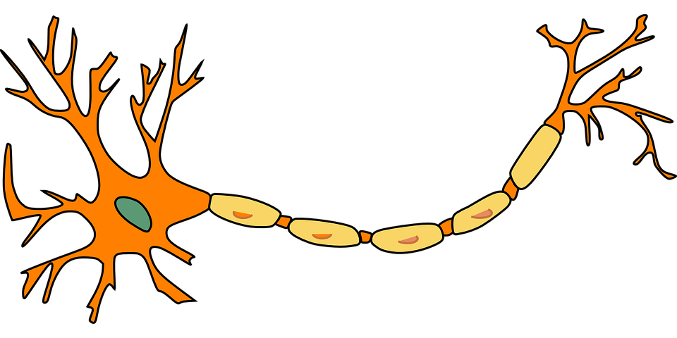
Funktionsweise faltender neuronaler Netze

Slide 23
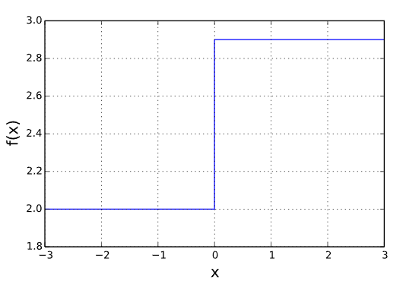
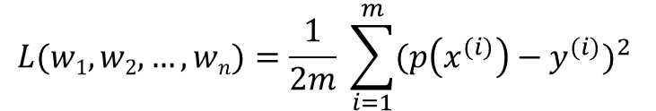
Das Single Layer Perceptron
p(x)
Die Fehlerfunktion
Parameter von Model als Eingabe
Gibt Abweichung des Models von Wahrheitswerten zurück
Mean Squared Error Funktion:
w₁
z = X₁*w₁ + X₂*w₂ + … + X_{n}*w_{n}
Y = f(z)
X₁
w₂
X₂
Y
…
$$L(w1, w2, …, wn)=\frac{1}{2m} \sum_{i=1}^{m}{{(p\left(x^{(i)}\right)−y^{(i)})}^{2} }$$
w_{n}
X_{n}

Slide 24
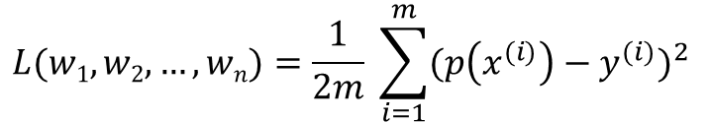
Das Single Layer Perceptron
p(x)
$$L(w1, w2, …, wn)=\frac{1}{2m} \sum_{i=1}^{m}{{(p\left(x^{(i)}\right)−y^{(i)})}^{2} }$$
w₁
z = X₁*w₁ + X₂*w₂ + … + X_{n}*w_{n}
Y = f(z)
Das Gradientenverfahren
Iterativer Algorithmus, um differenzierbare Funktion zu minimieren
Hilfsmittel, um Fehlerfunktion zu optimieren
X₁
w₂
X₂
Y
…
w_{n}
X_{n}

Slide 25
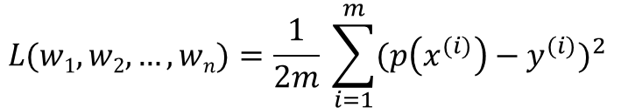
Das Single Layer Perceptron
p(x)
$$L(w1, w2, …, wn)=\frac{1}{2m} \sum_{i=1}^{m}{{(p\left(x^{(i)}\right)−y^{(i)})}^{2} }$$
w₁
z = X₁*w₁ + X₂*w₂ + … + X_{n}*w_{n}
Y = z
Das Gradientenverfahren
Iterativer Algorithmus, um differenzierbare Funktion zu minimieren
Hilfsmittel, um Fehlerfunktion zu optimieren
X₁
w₂
X₂
Y
…
w_{n}
X_{n}

Slide 26
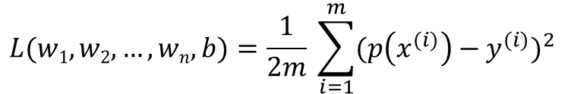
Das Single Layer Perceptron
p(x)
$$L(w1, w2, …, wn,b)=\frac{1}{2m} \sum_{i=1}^{m}{{(p\left(x^{(i)}\right)−y^{(i)})}^{2} }$$
w₁
z = X₁*w₁ + X₂*w₂ + … + X_{n}*w_{n} + b
Y = z
Das Gradientenverfahren
Iterativer Algorithmus, um differenzierbare Funktion zu minimieren
Hilfsmittel, um Fehlerfunktion zu optimieren
X₁
w₂
X₂
Y
…
w_{n}
X_{n}
b

Slide 27
Das Single Layer Perceptron
p(x)
w₁
z = X₁*w₁ + X₂*w₂ + … + X_{n}*w_{n} + b
Y = z
X₁
w₂
X₂
Y
…
w_{n}
X_{n}
b
1

Slide 28
Das Single Layer Perceptron
p(x)
w₁
z = X₁*w₁ + X₂*w₂ + … + X_{n}*w_{n} + b
Y = f(z)
X₁
w₂
X₂
Y
…
w_{n}
X_{n}
b
1

